Slide 1
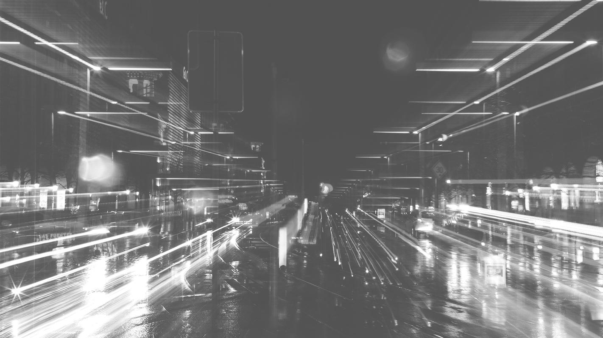
IoT in Robot Car
IoT Systems
Group 1

Slide 2
Table of contents
01
Introduction
04
Website
02
Use of Sensors
05
Advance Implementation
03
Cloud
06
Limitations And Future

Slide 3
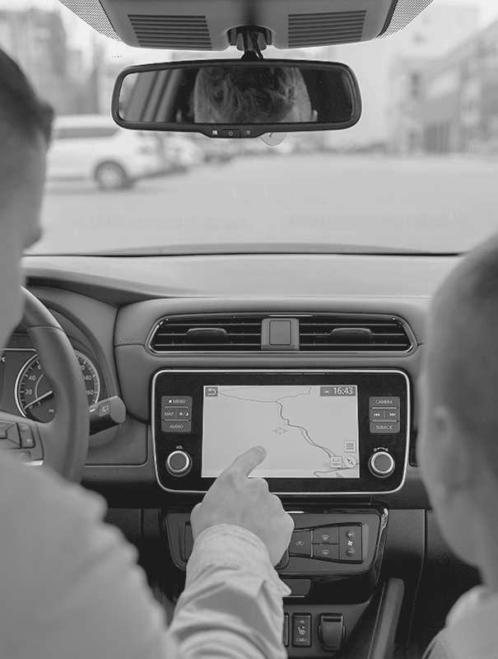
01
Introduction
Robot Car
Aka: Tesla Ultra Pro

Slide 4
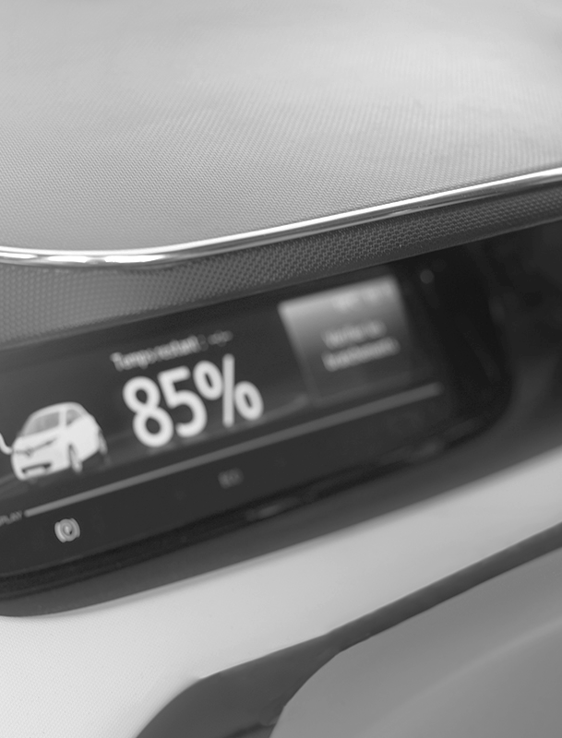
About the project
Robot car with many outstanding features such as collision avoidance, and danger. Global control access, but with extremely tight security. Store valuable data for future development. And 100% use electricity.

Slide 5
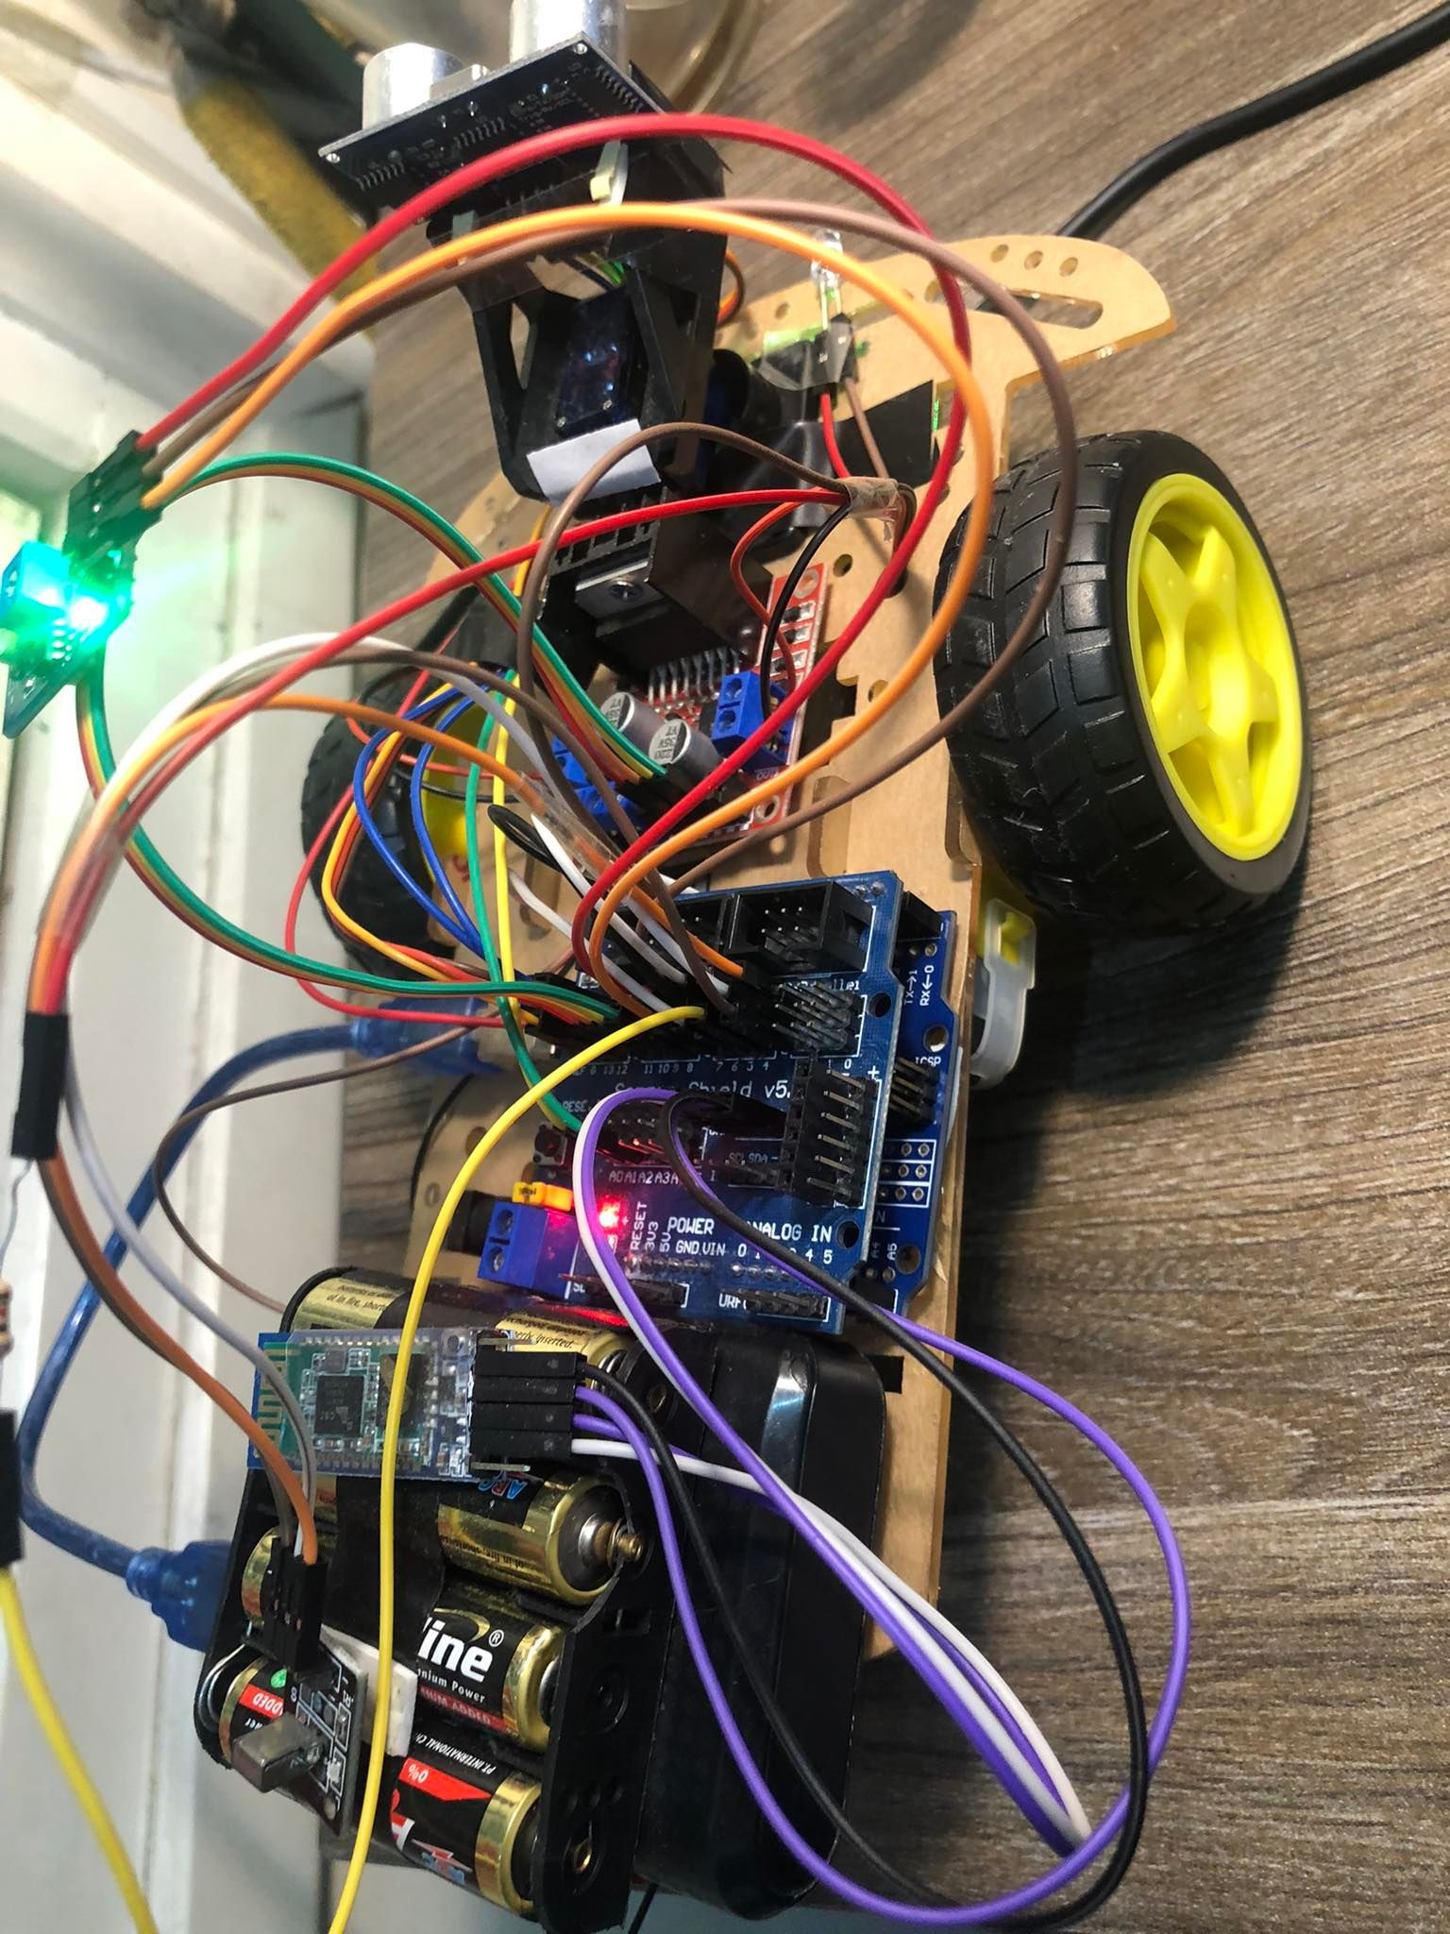
Robot Car
These are semi-autonomous cars infused with IoT that, in addition to making decisions, control a portion of the vehicle's operations to prevent accidents
Arduino

Slide 6
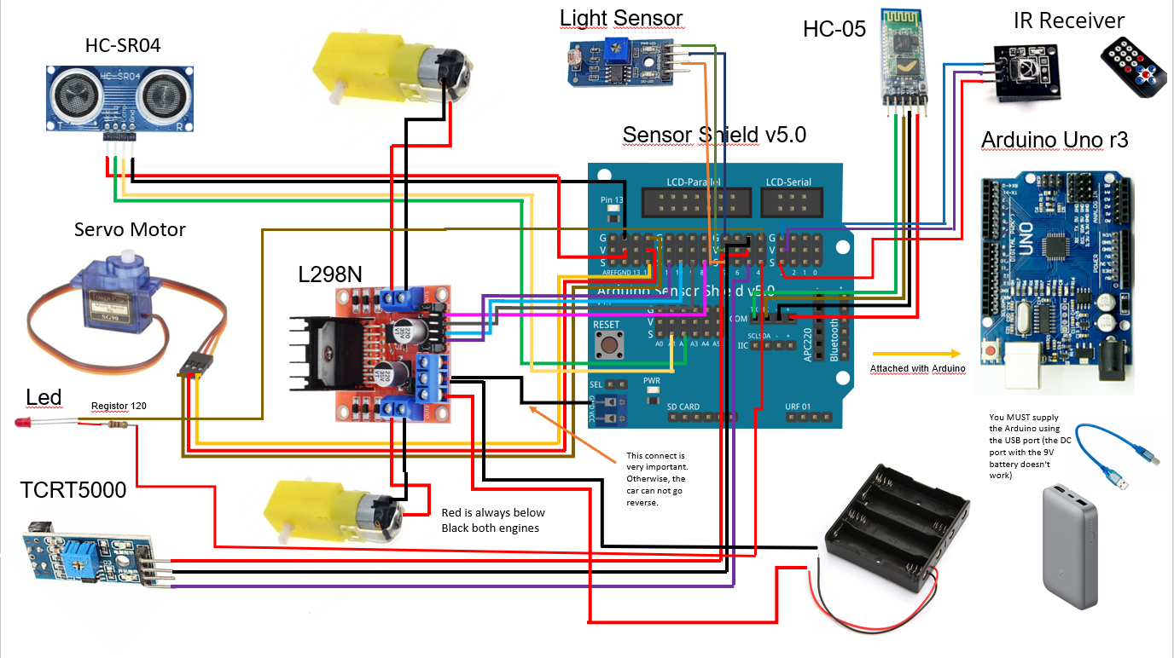
Structure Map

Slide 7
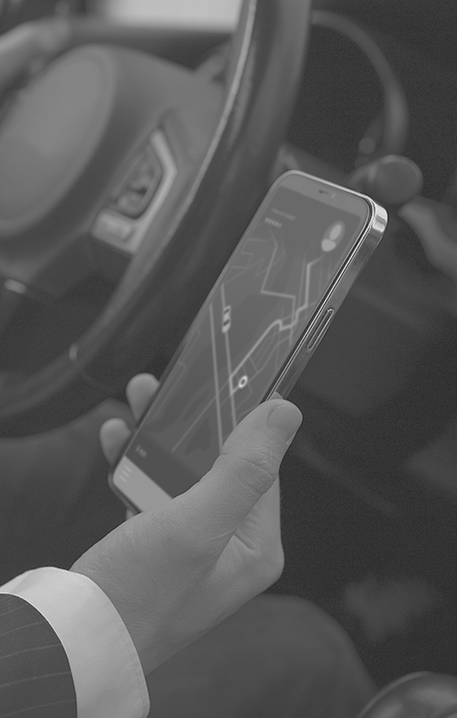
02
Use of Sensors

Slide 8
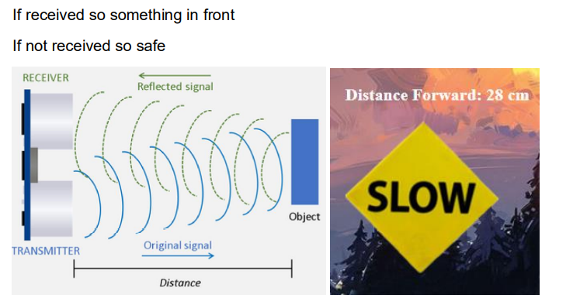
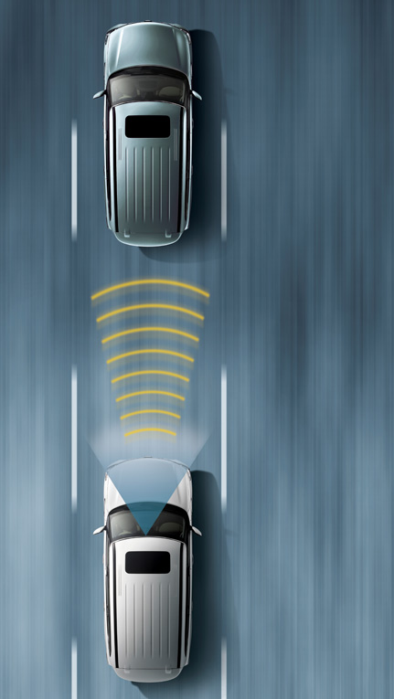
UltraSonic Sensor

Slide 9
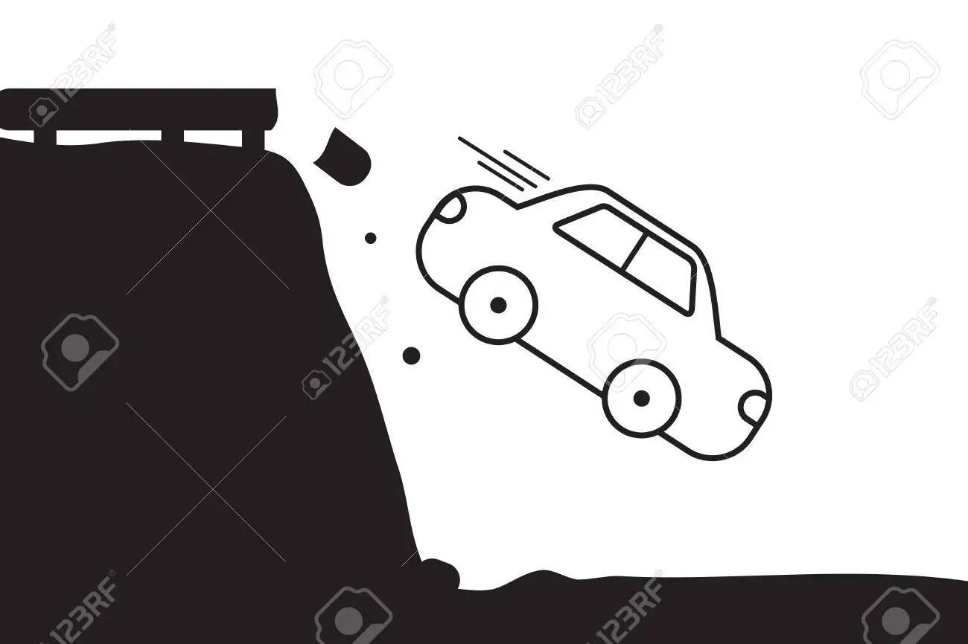
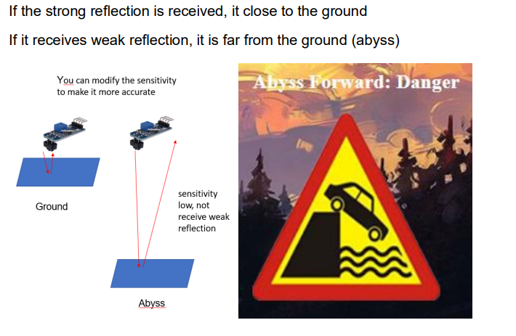
Infrared Sensor

Slide 10
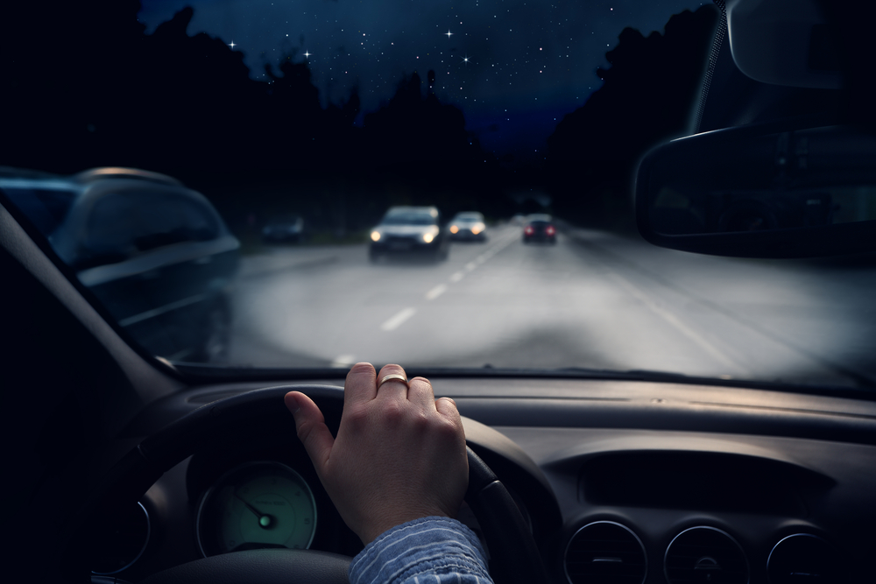
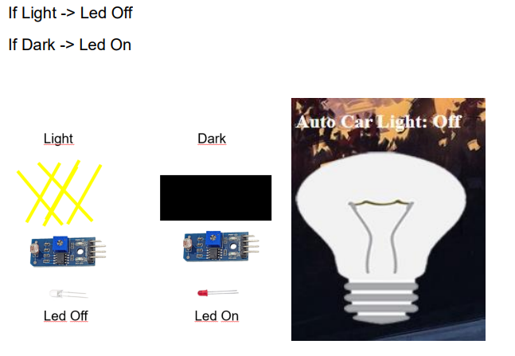
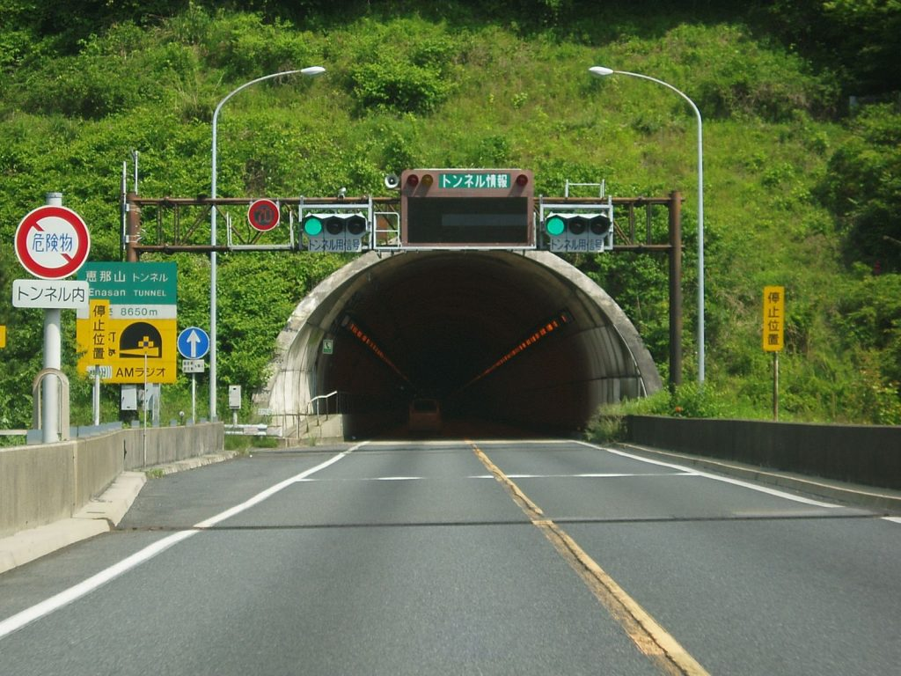
Light Sensor

Slide 11
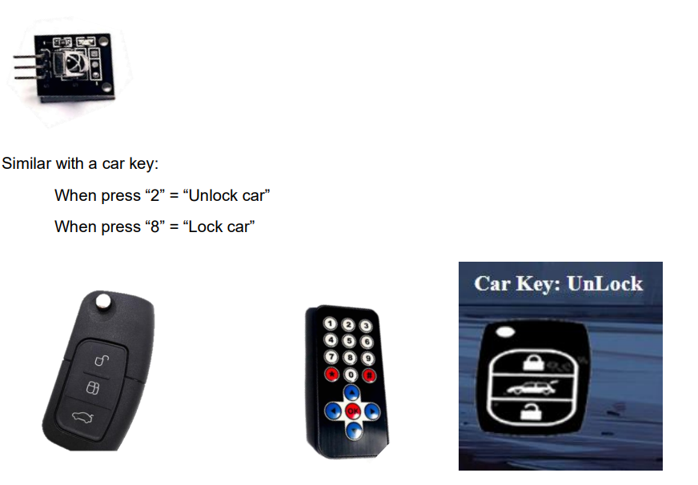
IR Receiver

Slide 12

03
Cloud

Slide 13
Google Firebase
Cloud Messaging
Cloud Database
Used to communicate between system edges.
MQTT communication protocols followed
Used to store data in a JSON structure.

Slide 14
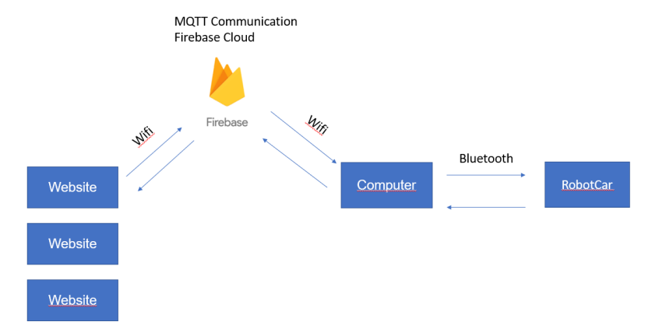
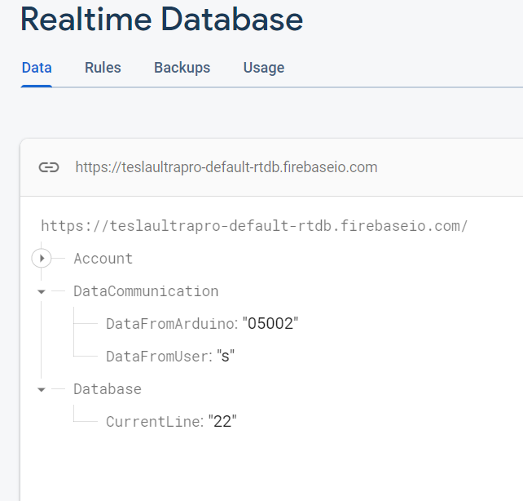
Cloud Messaging

Slide 15
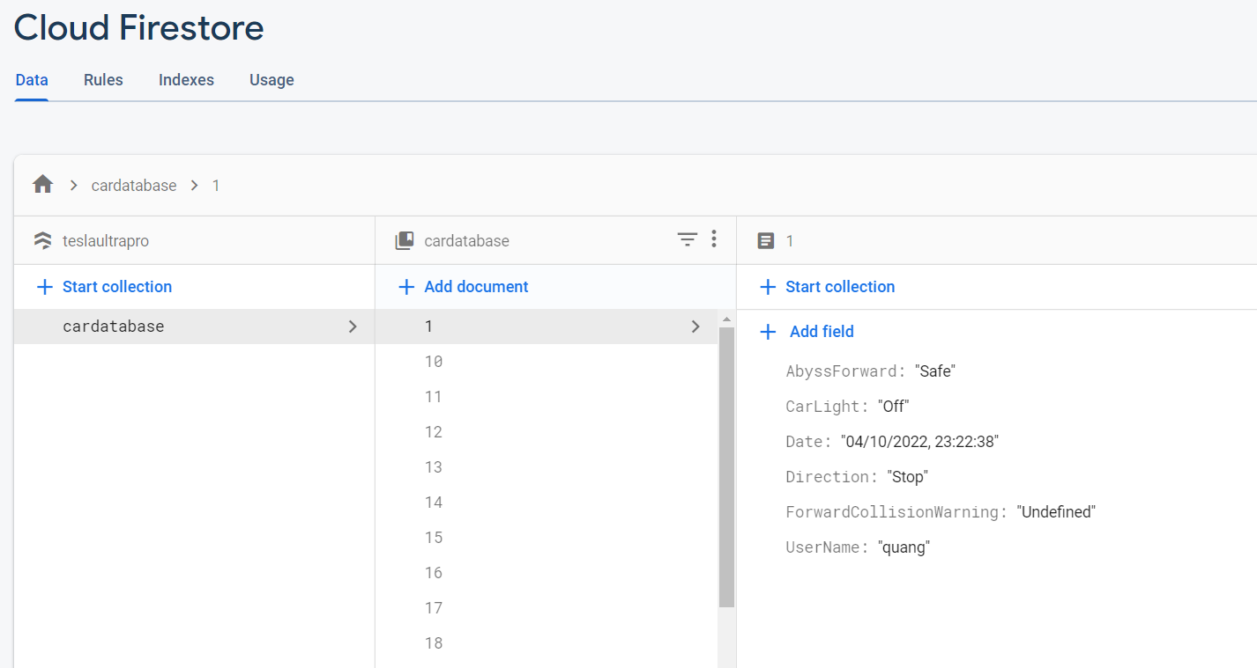
Cloud Database

Slide 16
04
Website
Google Hosting, Global Access
Responsive web for all devices

Slide 17


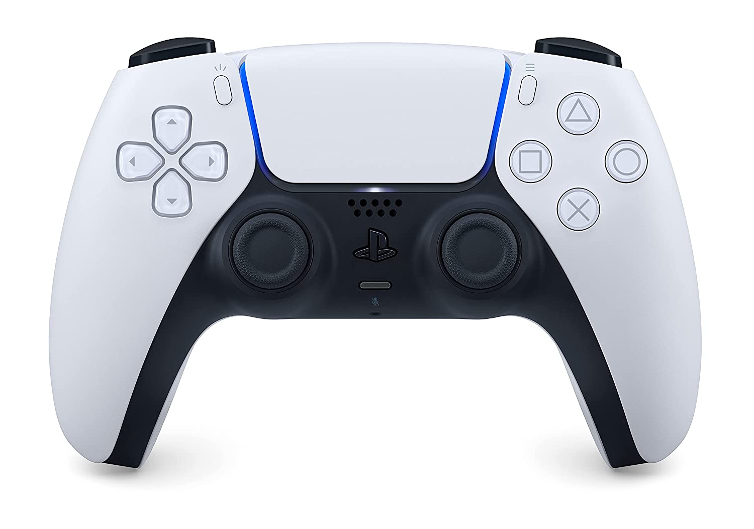
User Roles
Controller
Viewer
Admin
Link: https://teslaultrapro.web.app/

Slide 18
05
Advance Implementation

Slide 19
Think out of the box
Voice recognition
Virtual Steering
Blockchain Concept

Slide 20
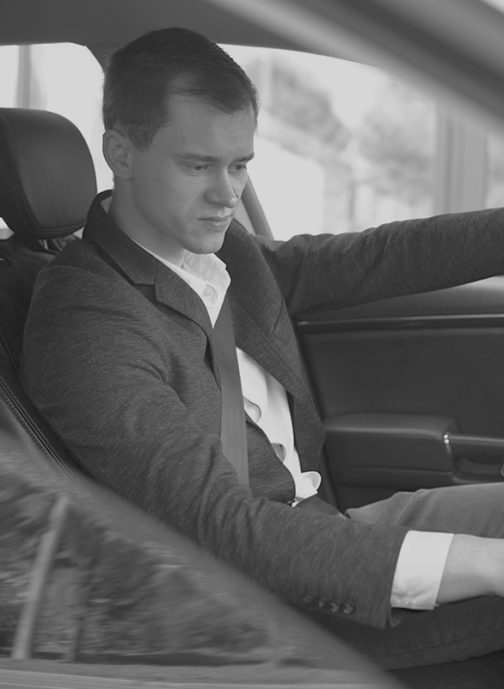
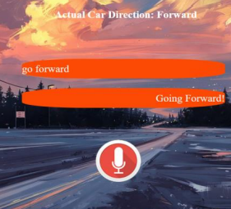
Voice recognition
Use WebKit to recognize what the user say
Evaluate that data

Slide 21
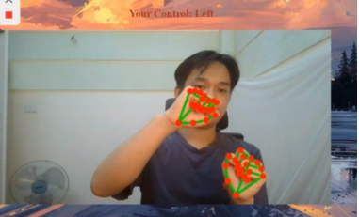

Virtual Steering
Using MediaPipe
A library for hand detection
Google Again =))))))

Slide 22

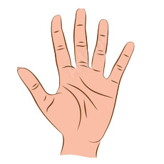
Virtual Steering
No Hand = Stop
Only One Hand = Stop
Two Hands, Open = Stop
Two Hands, Close, Right Higher
= Left
Two Hands, Close, Left Higher
= Right
Two Hands, Close = Forward

Slide 23
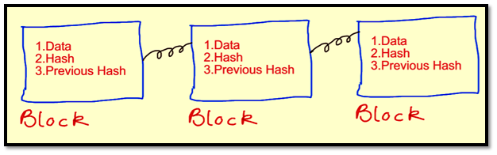
Blockchain Concept
For website security - illegal access is prohibited
If any node fail the whole process fail
Real Blockchain
Suppose: if you currently have access to the control page but the server suddenly shuts down then you are no longer on the control page
My Version
Allow Access
Allow Access
Server / Arduino
Login Site
Control Site

Slide 24
06
Limitations And Future
Every system has its limits
Always have ideas for improvement

Slide 25
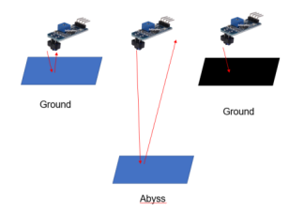
Limitations
Warning Abyss will be false if moving over ground that is black. Physics says that black color does not reflect light. And the sensor will recognize it as an abyss

Slide 26

Limitations
Bro, why are you so heavy ???
I love battery!
……….

Slide 27
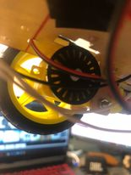
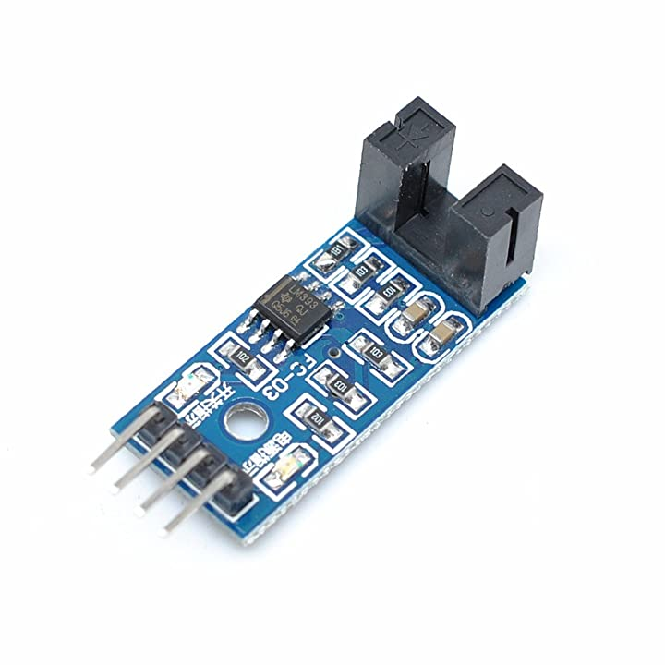
Future
About the robot
Add speed sensor
In the wheel, there is a disc (with a gap) attached to the axis of rotation of the wheel. The speed sensor transmits a wave/ray/signal between its two columns. If we put the other disc in the middle of the gap as the wheel rotates, that signal/ray will continuously turn on and off. Assuming the disc has 2 slots after 2 turns on and off, the disc rotates 1 revolution and so does the wheel. From there, according to the circumference of the wheel, we can determine the speed.

Slide 28
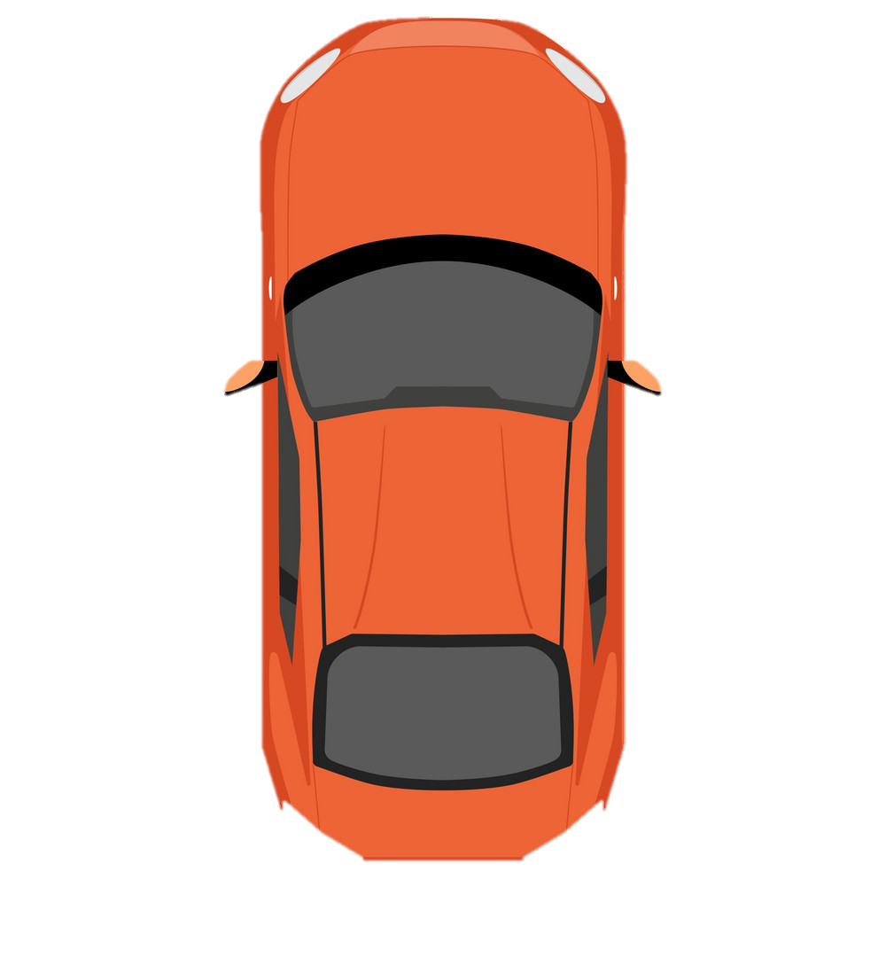
Future
GPS Clone Idea !!!
No need GPS module
Turn left and record how many seconds it takes to complete the 360-degree turn. Assume 4s = 360 degrees
Forward 1s = 1 value
Reverse 1s = -1 value
Then do the same with the right

Slide 29
Future
Let’s do:
0.3333s Left, 1s Forward
y
You have:
4s Left = 360 degree
4s Right = 360 degree
1s Foward = +1 value
1s Reverse = -1 value
1/2
Sqrt(3)/2
1
1
30
0,0
1
x
So you always can calcualte the location of the car in the map
Now is (1/2, Sqrt(3)/2)

Slide 30

Future
Next:
0.3333s Right, 1s Forward
y
You have:
4s Left = 360 degree
4s Right = 360 degree
1s Foward = +1 value
1s Reverse = -1 value
1
30
1
1
30
1
x
0,0
Calculate your point then have a set of points
It's just my idea, when it comes to practice, a lot of other things will happen
Putting in x, y requires a lot of operations, such as:
+) when turning left and forward, x decreases but y increases
+) when turning right and forward, x increases and y increases
+) if the direction of the car parallel with x or y what will happens

Slide 31
Thank you!
Group 1:
Hoang Nhat Quang
Le Anh Quan

